Slide 1

Introduction to Tibero
2021. 10.
TmaxData
Copyright(c) 2021. Tmax All Rights Reserved.

Slide 2




Chapter 1
Introduction to TmaxData

Slide 3





Tmax, System Software Enterprise
Tmax is a global software innovator that delivers a complete stack of solutions that help customers efficiently manage and fully leverage their critical data.
Better Technology, Better Tomorrow
About 1,200 of R&D employees
History and Business Achievements
Four core system software (middleware, DBMS, OS, and cloud) industry with proprietary technologies.
Middleware, No. 1 market share in South Korea’s middleware market.
Database, No. 1 market share growth in South Korea’s DBMS market.
OS/Cloud, developing a new market.
System Software Technology
MW
DBMS
OS
Cloud

Slide 4







TmaxData, Rapid Growth
TmaxData is the most remarkable database specialist company with 34.8% year-on-year growth, raising awareness and strengthening corporate competitiveness thanks to large-scale strategic business orders, successful sales force improvement, and improved technical support process.
2003 ~ 2007
2008 ~ 2013
2014 ~ 2019
2020년 ~
Specializing in DB
The Representative of DB
In Korea
Proof Technology
Continuous Growth
Launched Tibero 1.0(‘03)
Tibero 6 FixSet07 (Current Version)
Held by only 2 companies in the world. TAC* vs RAC(‘08)
* Tibero Active Cluster
Registered as Magic Quadrant, Gartner (‘15)
Hyundai Motor Group's DB conversion contract(’19)
Corporate spin off, TmaxData (‘20)
Samsung, KT, DB Win-back Contract (‘20)
Tibero Reference Over 7,000 (‘21)

Slide 5
Chapter 2
Introduction to Tibero

Slide 6

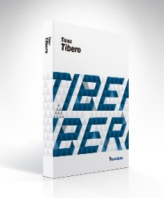
Tibero Overview
Tibero 6 is a high-performance, highly secure, highly scalable relational database management system (RDBMS) for enterprises that want to fully leverage their mission-critical data.
Korea’s first disk-based RDBMS
Shared Disk-Based TAC* Tech.
Launched Tibero 1.0 in 2003
Only 2 Companies in the world
952 TAC References
Korea’s the leader of DBMS
No. 1 DBMS growth rate in the past 3 years
Public IP
Virtual IP
Scale Out
…
Interconnect
Tibero
#1
Tibero
#2
About 7,000 References
About 7,000 References (’21. July)
1,000 Win-Back References (Oracle 85%, MS-SQL/DB2 etc. 15%)
Active
Active
Storage
*TAC, Tibero Active Cluster

Slide 7

Tibero Overview
Ensure stability, high performance, convenience, and compatibility,
which are the four most important elements of DB.
Various backup & recovery
TAC based on shared disk
TSC based on disk mirroring
DB encryption (TDE) and access control.
Row Level Lock, MVCC
Parallel Processing for large amount of data
Various Index & Partition table Functions
CBO-Based Optimizer & Various Hints
High
Performance
stability
Enterprise
DBMS
Monitoring/development tools provided.
Provides various utilities for DBMS management.
Supports interworking with 400 3rd Party solutions.
convenience
compatibility
Standard SQL & Interface
Support Oracle SQL & PL/SQL
Support Interconnect heterogeneous database through DB Link

Slide 8

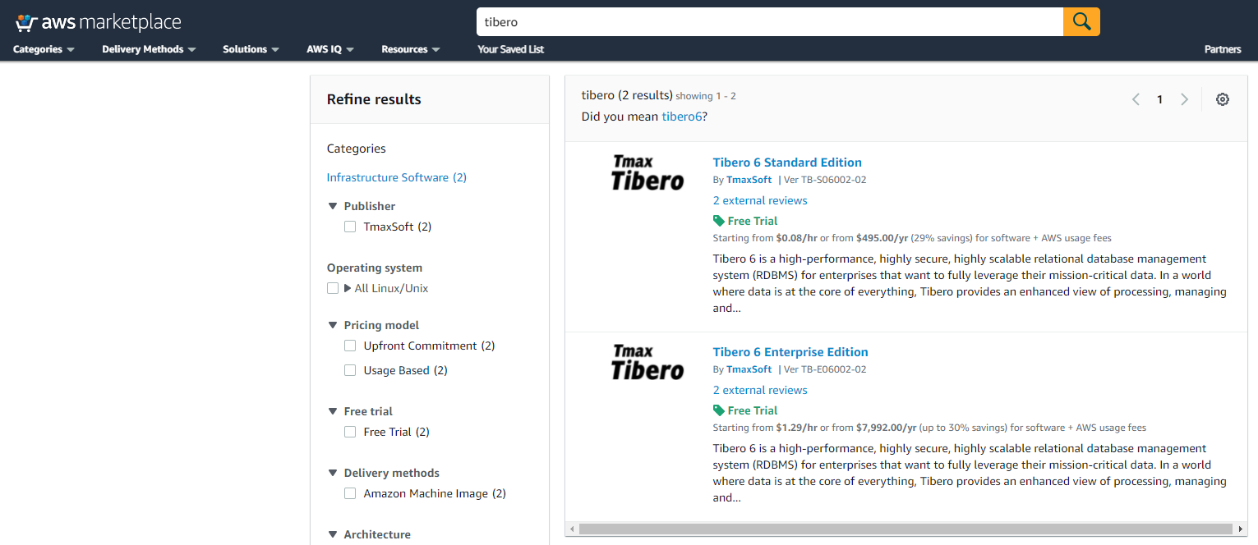
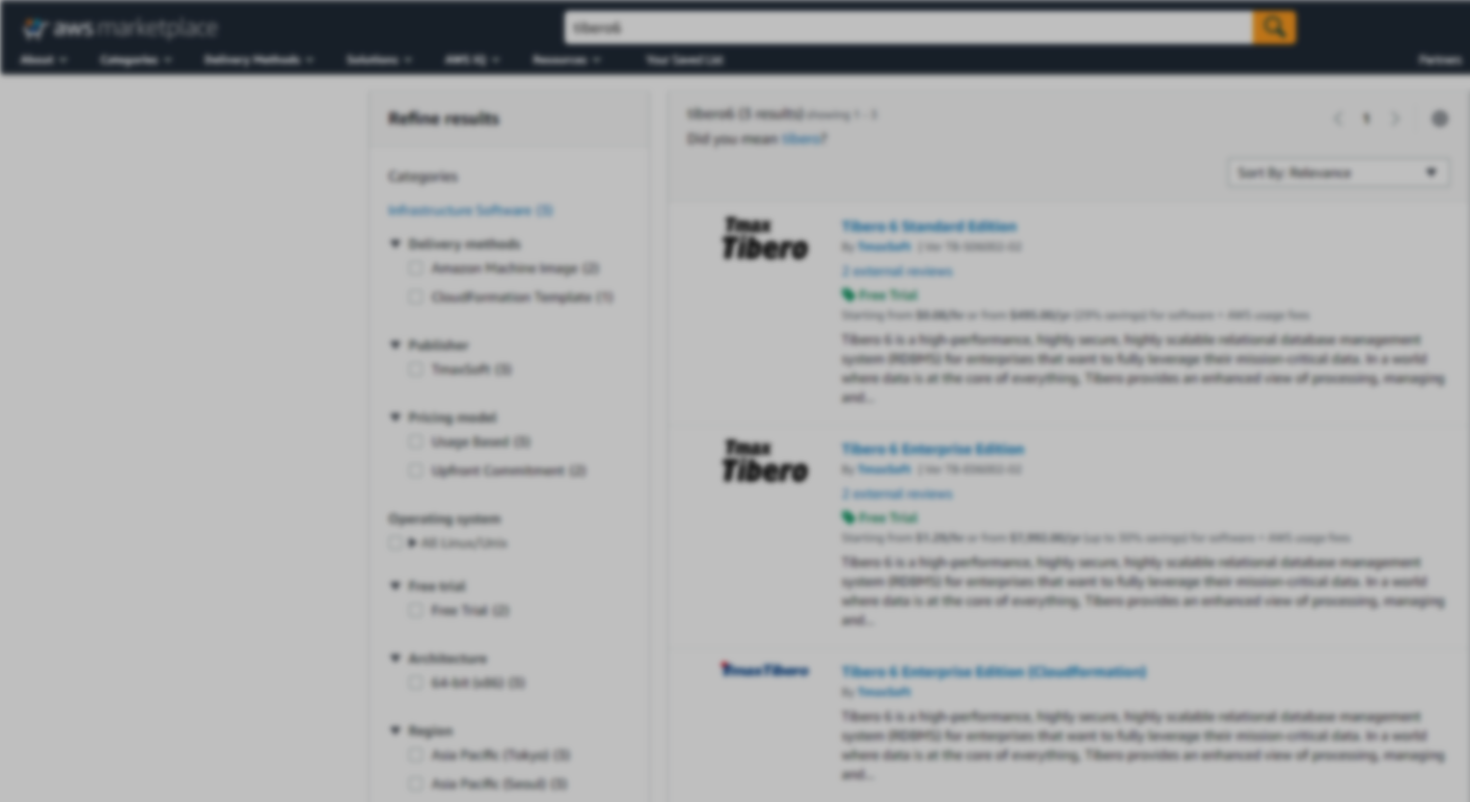

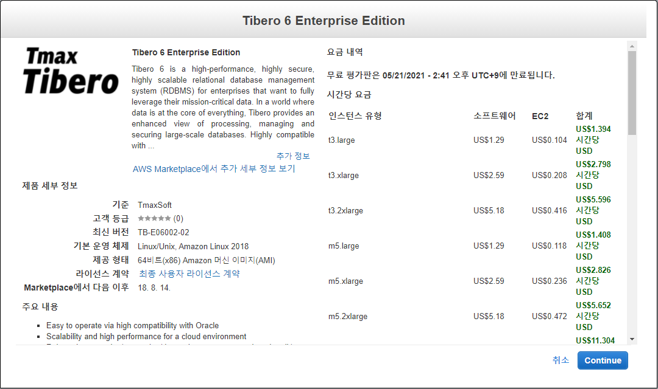

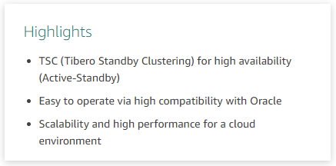
Tibero on AWS Market Place
Tibero already has been verified through registering in AWS Marketplace and Cloudformation
Tibero Image was linked AWS-Marketplace : https://aws.amazon.com/marketplace/search/results?searchTerms=tibero

Slide 9
Tibero HA on AWS
Tibero provides measures such as TSC configuration and HA configuration using Cluster S/W for high availability support in a Public Cloud environment.
TSC(Tibero Standby Cluster)
CDC Synchronization Solution
HA Config(Using Cluster S/W)
Tibero on AWS
CDC
Sync
Redo
Shipping
Tibero
(Primary)
Tibero
(Secondary)
Tibero
#1
Tibero
#2
Tibero
#1
Tibero
#2
Cluster S/W
Cluster S/W
Active
Active/
Standby
Active
Active
Storage
Storage
Storage
Storage
Active
Standby
Storage
Tibero provides high availability by providing various redundancy configurations within AWS.

Slide 10
Chapter 3
Quickstart Architecture of TSC

Slide 11
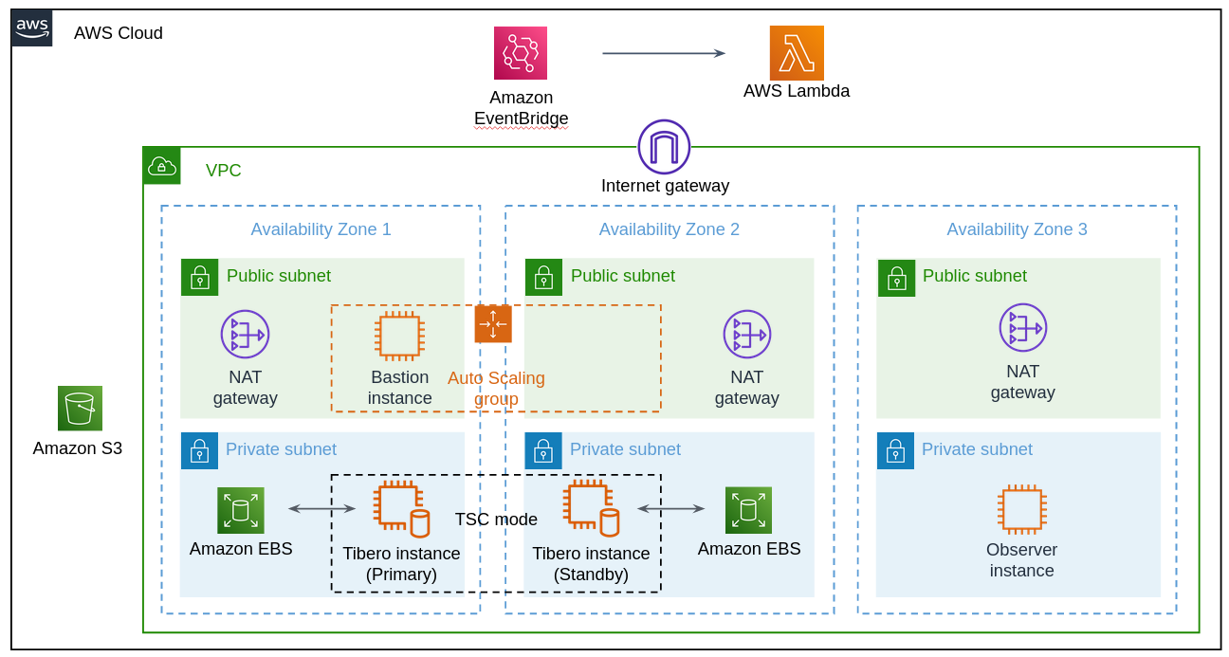
QuickStart Architecture Diagram

Slide 12
Describe of The Diagram
TSC Quickstart consists of three AZs, each of which is built with a Primary DB, a Standby DB, and an Observer.
TSC mode: Tibero Standby Cluster mode to meet the high availability conditions of the DB. Standby DB is a recovery mode and waits with only the redo log files of the Primary DB stored.
The Observer recognizes the down of the Primary DB and automatically switches the Standby DB to the Primary DB.
Reboot when the Observer process is down using Amazon EventBridge & AWS Lambda, or reboot to Standby DB(recovery mode) when the Primary DB is down to maintain TSC mode continuously.

Slide 13

Thank you
Tmax Co., Ltd.
Tmax Sunae Tower, 29, Hwangsaeul-ro 258beon-gil, Bundang-gu, Seongnam-si, Gyeonggi-do
Tel. 031-8018-1000 Fax. 031-8018-1115 kr.tmaxsoft.com

